Slide 1
Elevator
Algorithm
201533673 최준헌
201835462 박해원
201835476 유근혁

Slide 2
Main Idea
Function
Simulation
Role
INDEX

Slide 3
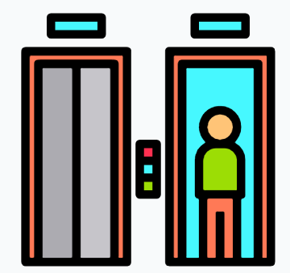
1. Main idea
What is our motivation and goal?
MOTIVATION
Currently, elevator in IT building is too long waiting time.
GOAL
To reduce the waiting time for elevator

Slide 4


2. Function
Main Algorithm
Do.
3 elevator iterate with constant distance.
It rotate in single - way.
Then.
This method reduces total waiting-time by reducing time that the elevator goes up and back down to pick other passengers up.

Slide 5
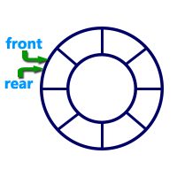


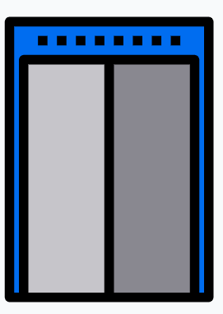
2. Function
ENQEUE UP QUEUE
I WANT
TO GO F3!
Each floor has two Circular queue.
Passenger Generation
UP Door
#F1
DOWN Door

Slide 6
2. Function
Elevator State : STOP ➔ RUN
UP Door
DOWN Door

Slide 7
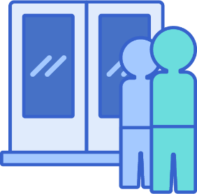
2. Function
#F6
DEQUEUE Floor’s Circular queue
RUN
Check if there are passengers on the floor, running elevator.
IF EXIST PESSENGER
If there're passengers, dequeue the passengers from the queue and insert them into the elevator destination list of which reaches the destination most early by distance-ascending-order.
UP Door
DOWN Door

Slide 8

2. Function
DELETE PESSENGER
IF ELEVATOR REACHES DESTINATION
Determine, with the state of elevator, whether continue running or not after delete the passenger from the list.
#Destination
Floor

Slide 9





2. Function
ESTIMATED ARRIVAL TIME
# 1F
1층
2층
3층
7층까지 20초 소요 예정 입니다!
4층
5층
6층
7층
8층
UP Door
DOWN Door

Slide 10
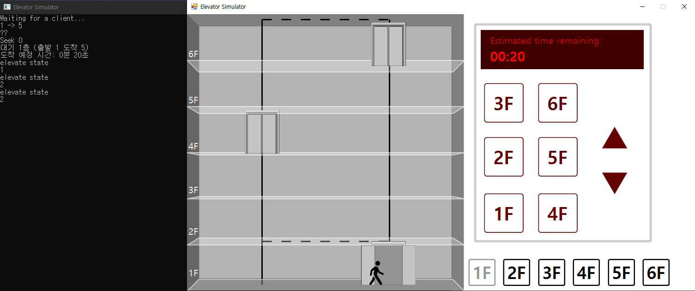
2. Function
ESTIMATED ARRIVAL TIME
Do.
Put the button outside the elevator, not inside.
Then.
Show the estimated arrival time when you push the floor button. After the passenger was registered, it compares the angle, find the closest elevator from the passenger.

Slide 11

CONSOLE
3. Simulation
SERVER WAIT CLIENT

Slide 12
3. Simulation
CLIENT WANT TO MOVE FROM 1F TO 5F
CONSOLE

Slide 13
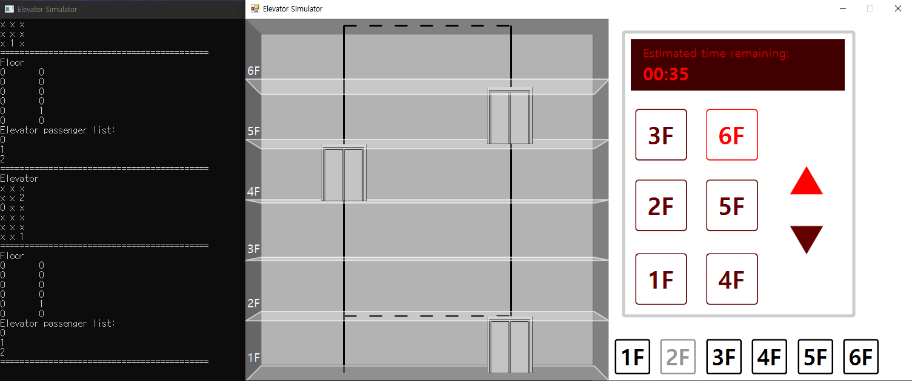
3. Simulation
CLIENT WANT TO MOVE FROM 2F TO 6F
CONSOLE

Slide 14
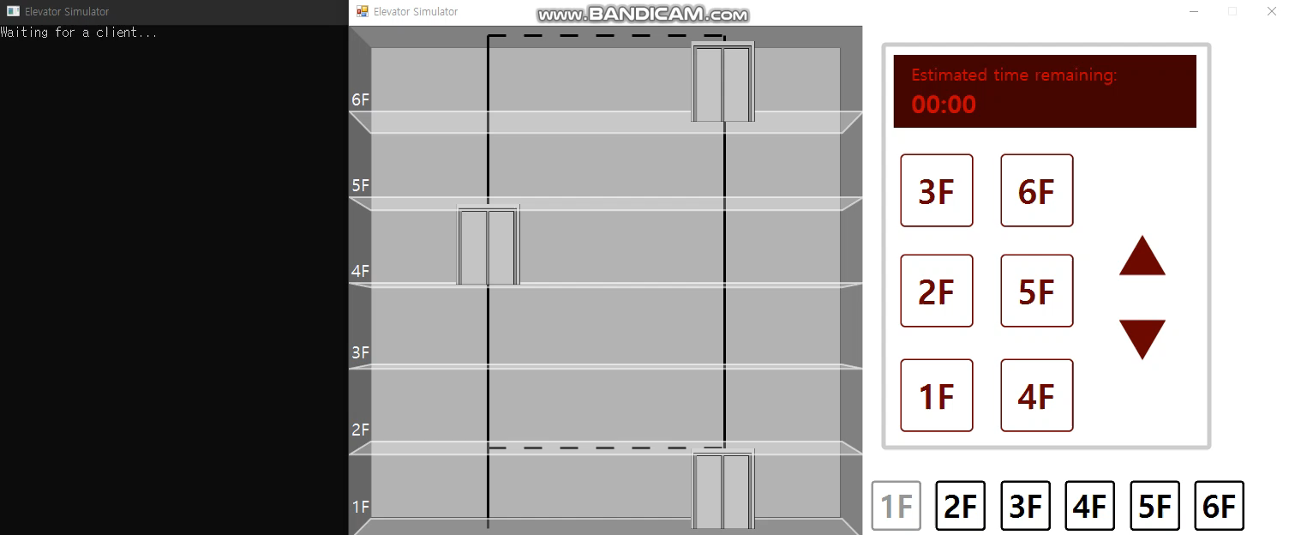
3. Simulation
CLIENT WANT TO MOVE FROM 4F TO 6F

Slide 15
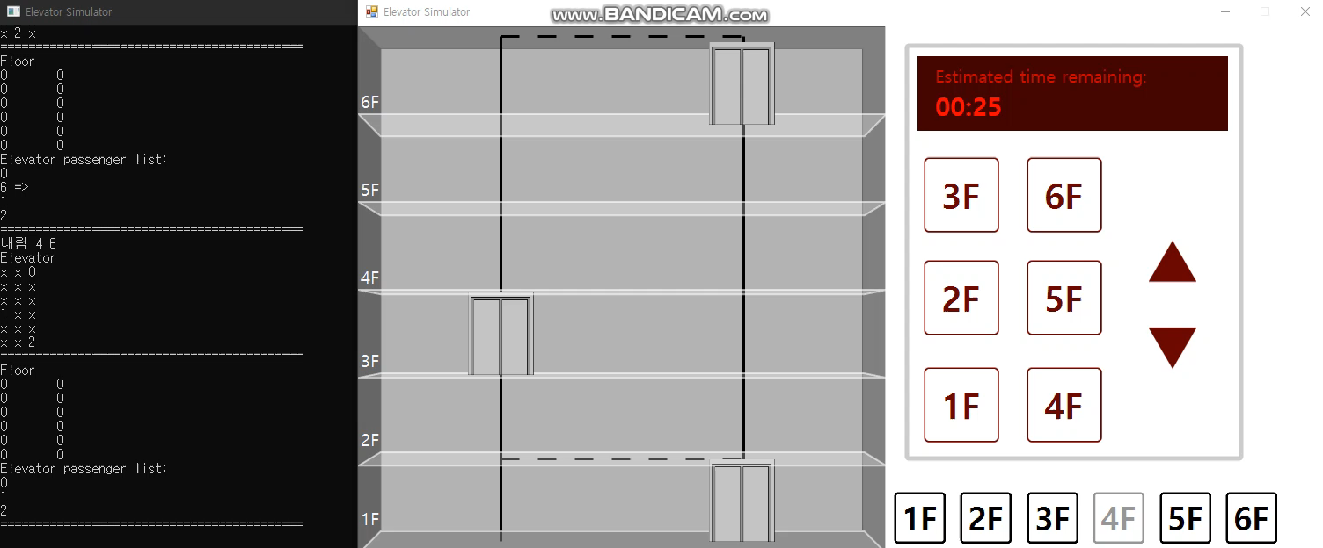
3. Simulation
CLIENT WANT TO MOVE FROM 6F TO 1F

Slide 16


4. Role
Choi Jun Heon
Main Algorithm Design
Additional Function Design
Debugging
UI Design
Park Hae Won
Main Algorithm Design
Networking
UI Design
Yu Geun Hyeok
Main Algorithm Design
Debugging
Networking
UI Design

Slide 17
THANK
YOU

